Slide 1

Ad Grants
Nonprofit Marketing Immersion
Pre-Campaign Report
Comitato Promotore San Michele Cammino di Cammini ETS - 08/05/2023

Slide 2
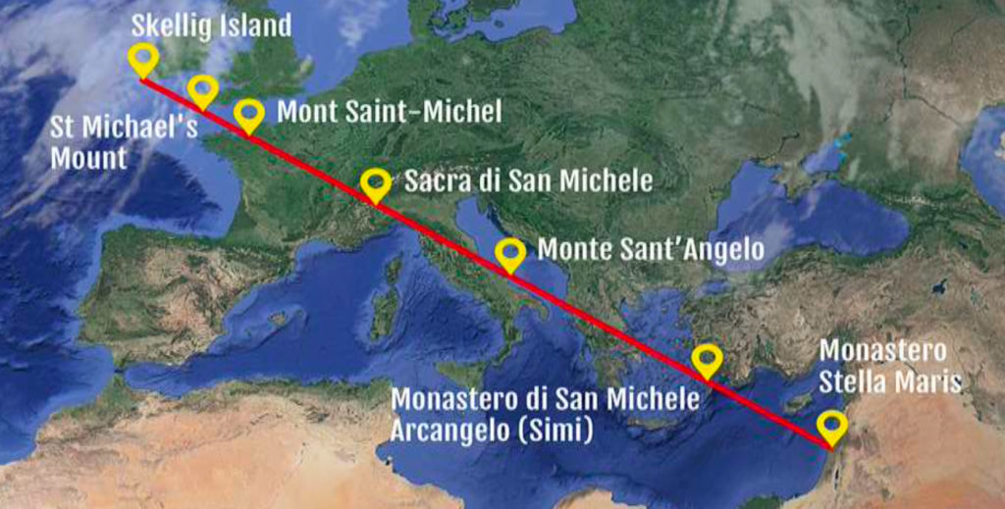
Nonprofit Overview
Cammino di San Michele
Website: https://www.camminodisanmichele.org/
Cause area: Arts, culture, humanities, environment
Location: Rome, Italy
Organization size: International organization
Years in operation: 6 (2017)
Services offered: Offering guidance and directions to those interested and organizing pilgrimages along the route.
Mission: Gather and organize Municipalities, Provinces, associations and volunteers on the Italian territory in order to recover, reclaim and promote ancient paths linked to faith and history of the archangel Michael.

Slide 3




Market and Target Audience Analysis
(08/3/23 - 12/4/23)
18-24
25-34
35-44
45-54
55-64
> 65
13.19%
Italy
Switzerland
Usa
France
Germany
91.31%
20.88%
2.87%
22.86%
2.78%
18.71%
1.63%
15.23%
Geography
Age
1.39%
9.1%
Male
Female
50.4%
Cooking enthusiasts
Green Living enthusiasts
Outdoor enthusiasts 2 {{example: frequent donors}}
Audience 3
Audience 4
Audience 5
49.6%
Gender
Interests

Slide 4



Current Marketing
Website Overview:
On the website, the user can get to know the organization’s goals and schedule, donate and sign up for the newsletter.
Online/Offline Marketing:
Online: posts on social media (Facebook, Instagram)
Offline: interviews with local and national TV News and newspapers
Current Ad Grants Campaigns:
2 campaigns monitoring the traffic on the website
Fundraising
What are they currently advertising (if they are already running campaigns)?
What opportunities do you see for different types of campaigns?

Slide 5
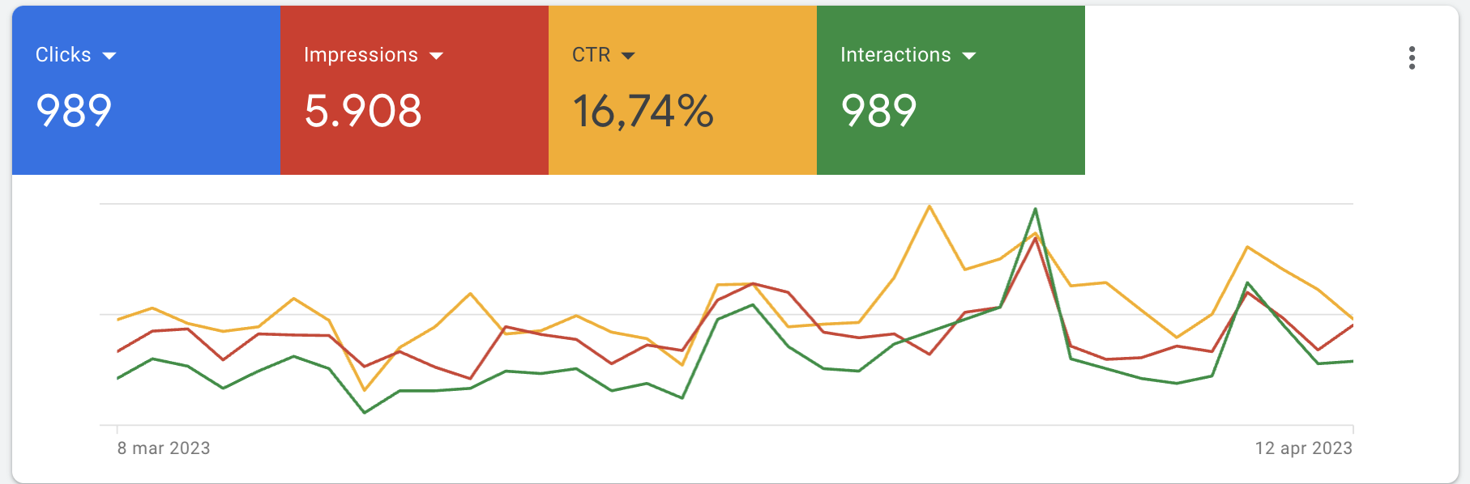
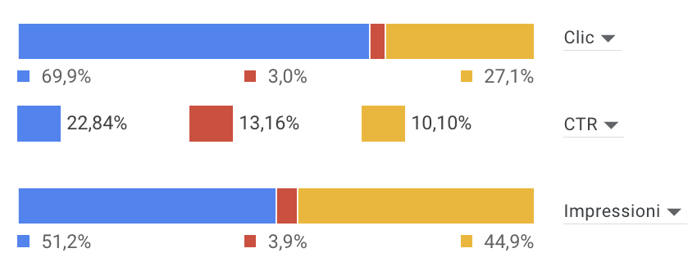
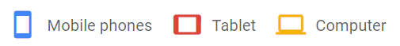
Current Account Performance
Clicks:
Impressions:
Clickthrough Rate (CTR):

Slide 6
Nonprofit Marketing Goals
Traffic: 5000 impressions but only 1000 clicks
The main goal from an awareness point of view is to make these routes known as an alternative to other, more famous, ones.
Create Awareness
The events promoted are linked to outdoors activities along the Michaelic routes, specifically in the italian regions of Piemonte and Toscana. These events usually engage about 50 people, and involve a several days journey walk. Since they cover a set amount of time, the events are easily marketable through campaigns.
Promote Events
Even though it is possible for users to donate through the website, there are no specific goals for donations as they are not one of the main focuses.
Donations

Slide 7
Proposed Strategies to Achieve these Goals
The main strategy is to create new campaigns that monitor the traffic on the website in terms of impressions and clicks with new keywords.
Create Awareness
For an upcoming event, we intend to create a campaign group focused on gathering subscriptions, working with keywords about holidays such as 25th of April and 1st of May.
Promote Events
To increase donations CTR, we’ll include sitelinks that directly point to the donation page.
Donations

Slide 8
Account Performance Metrics and Goals
(08/3/2023 - 12/4/2023)
Key Metrics | Current (“Pre”) | Target Goal | How
Clicks/Traffic | 989 | Increase (+3%) | Invest in better keywords
CTR % | 16.74% | Increase (+1%) | Ideate captivating and appealing ads
Impressions | 5908 | Increase | Set up new, more specific, campaigns Study the allocation of the budget
Conversion Rate | 0% (not set) | Set conversion rate | Introduce conversion tracking Maximize conversion value through bid strategy

Slide 9
Campaign Weekly Plan Summary
Start Date: 13/4/2023
End Date: Around 18/5/2023
13/4 - 19/4 | 20/4 - 26/42 | 27/4 - 3/5 | 4/5 - 10/5 | 11/5 - 17/5
Strategy
> Kickoff Meeting on 13/4/2023
> Identify & agree on:
Number of campaigns
Keyword strategy
Goals
Strategy
Create campaign for the event (22/4 - 1/5)
Create campaigns for brand awareness
Create campaigns for website traffic
Increase number of clicks and impressions
Exploit new keywords
Strategy
> Begin collecting performance data
> Compare results with previous period
> Closing Meeting

